Slide 1
Types of Blockchain

Slide 2
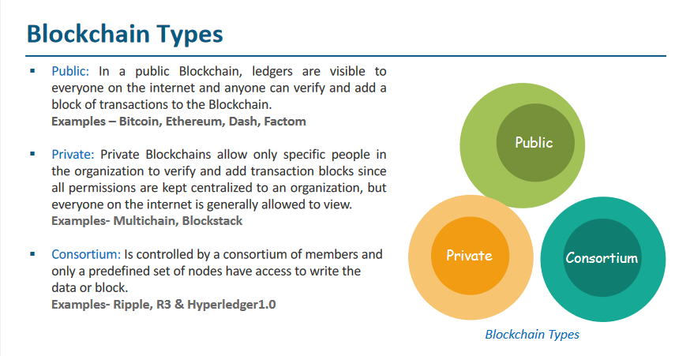

Slide 3
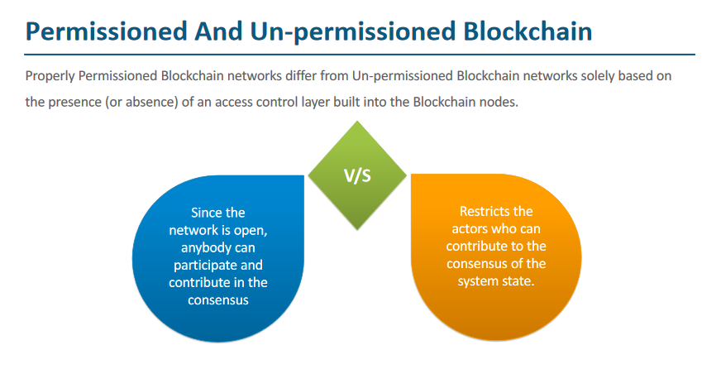

Slide 4
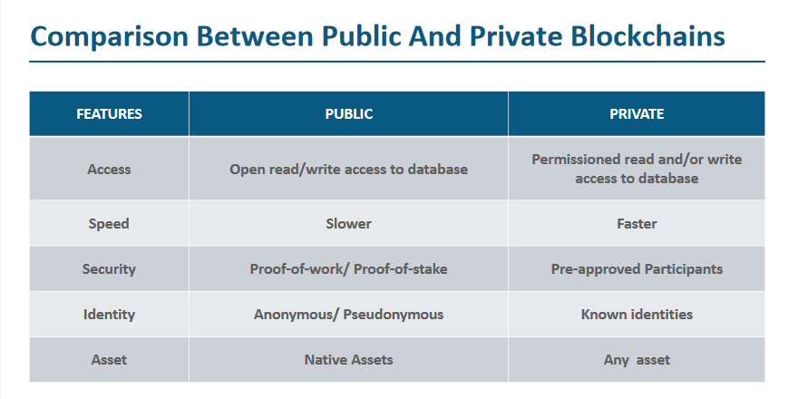

Slide 5
Introduction to Ethereum

Slide 6
What are the problems with Bitcoin Blockchain?
21 Million Bitcoins (Limited)
Mining: Electricity, Mining power, Time
Restricted to Cryptocurrency
Less Throughput
Script Can’t be changed : Locks and Unlocks
EIP 1559
32 ethers

Slide 7
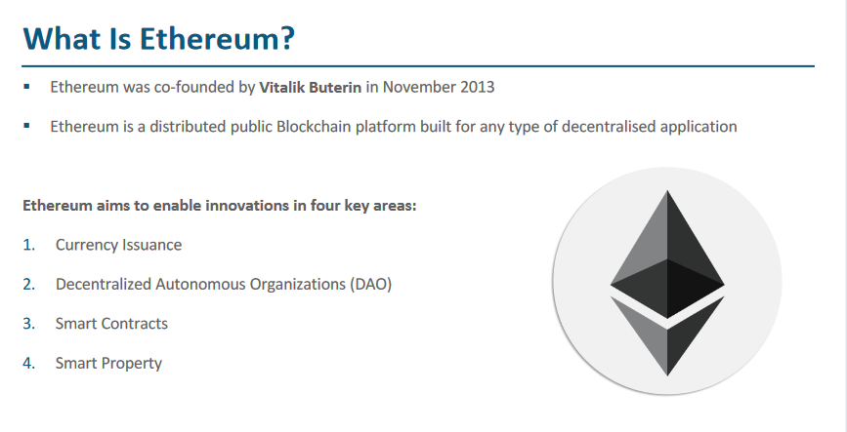

Slide 8
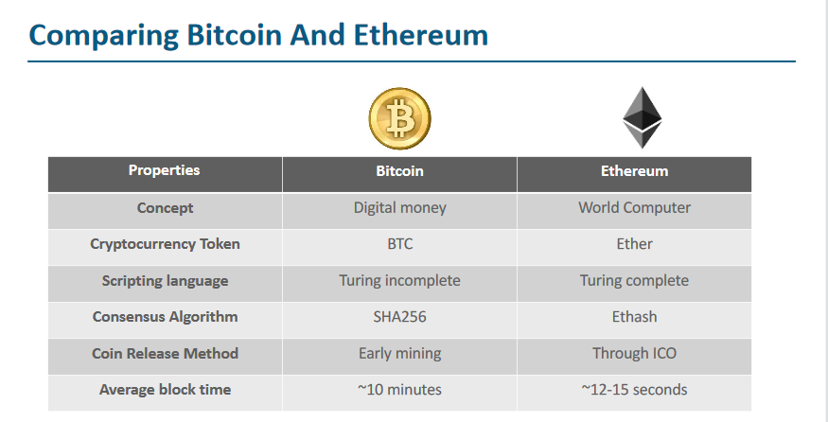

Slide 9
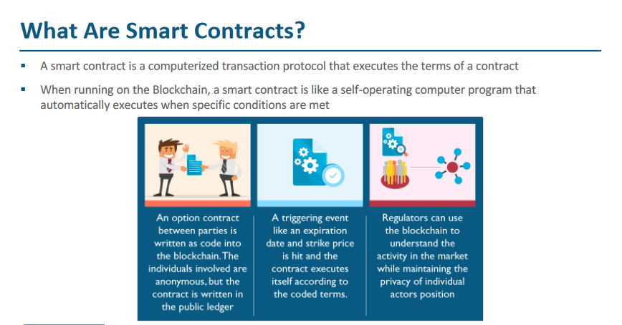

Slide 10
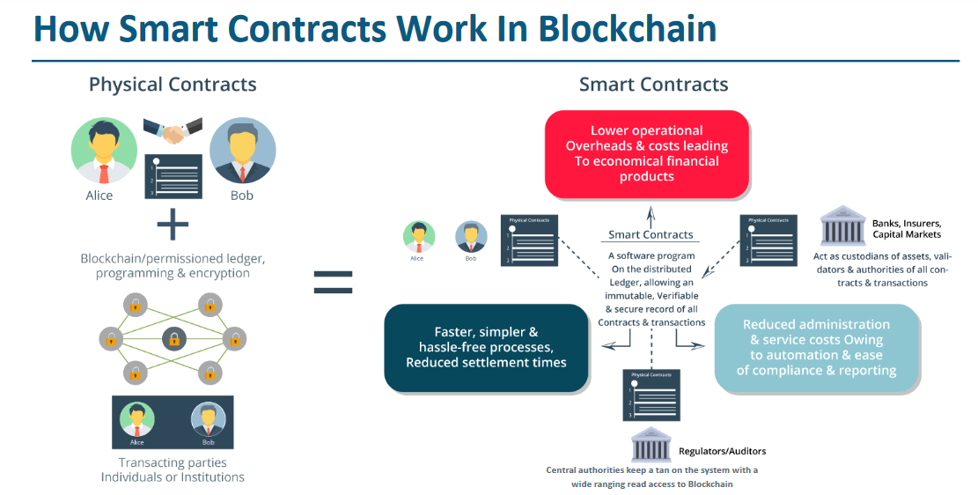

Slide 11
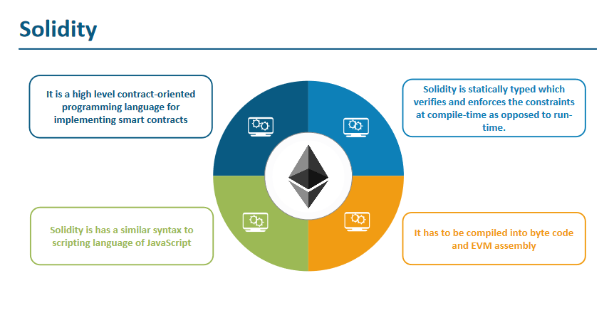

Slide 12
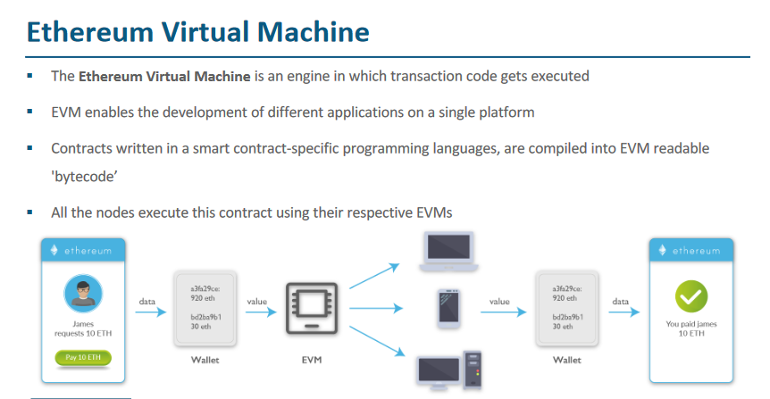

Slide 13
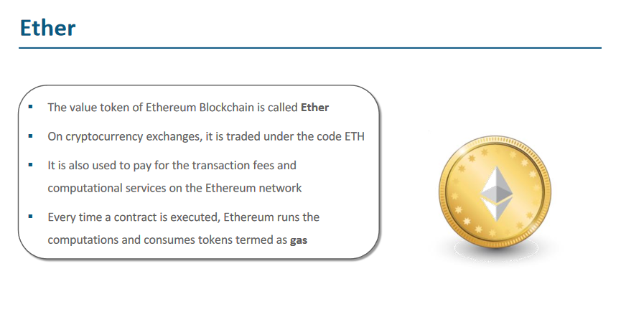

Slide 14
Gas refers to the unit that measures the amount of computational effort required to execute specific operations on the Ethereum network.
Since each Ethereum transaction requires computational resources to execute, each transaction requires a fee.
1 wei=10-9

Slide 15
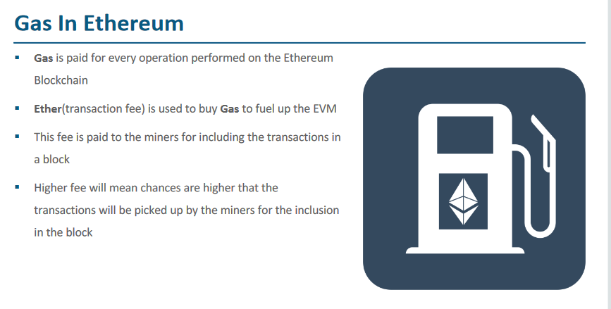

Slide 16
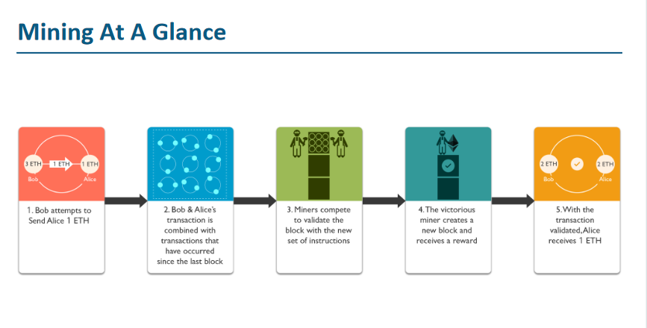

Slide 17
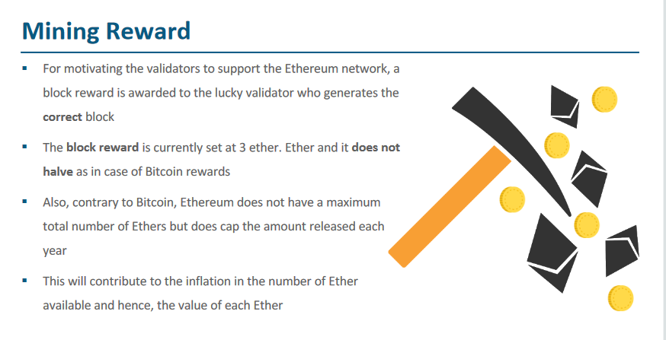

Slide 18
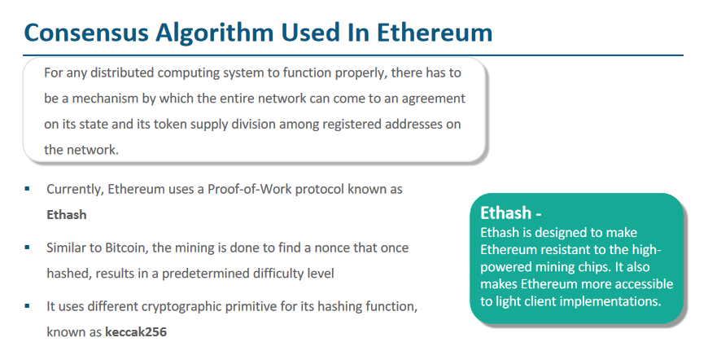

Slide 19
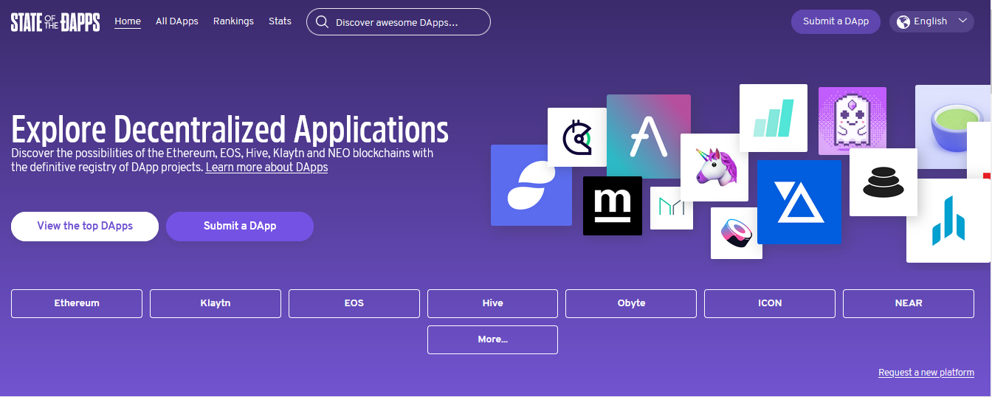

Slide 20
What are the benefits of dapps?
Censorship-resistant--With no single point of failure, it’s very difficult for governments or powerful individuals to control the network.
No downtime--Relying on a peer-to-peer system ensures the dapps continue to work even if individual computers or parts of the network go down.
Blockchain-based--As they are made of smart contracts, they can easily integrate cryptocurrencies into the basic functionalities of the Dapp.
Open-source--This encourages the widespread development of the dapp ecosystem enabling developers to build better dapps with more useful or interesting functions.

Slide 21
Components for Developing Ethereum DApps

Slide 22
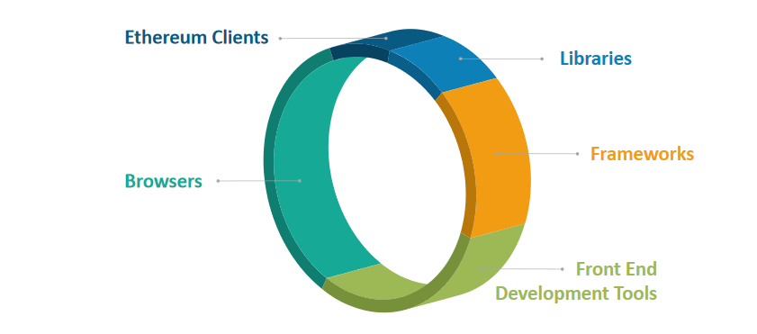

Slide 23
Ethereum Clients:
Interacts with Ethereum Network
Developers write contracts
Implements Ethereum Protocols
Mine Ethereum Blocks
Create/Manage Ethereum Accounts
Send/Receive Transactions

Slide 24
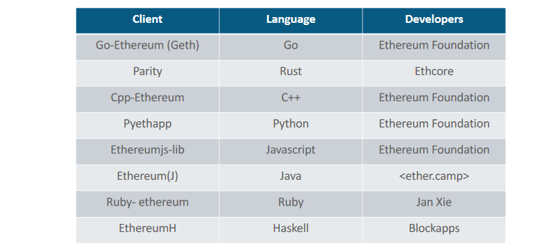
Ethereum Clients:

Slide 25
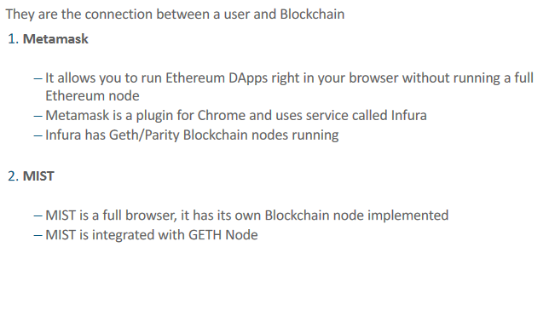
Browsers:

Slide 26
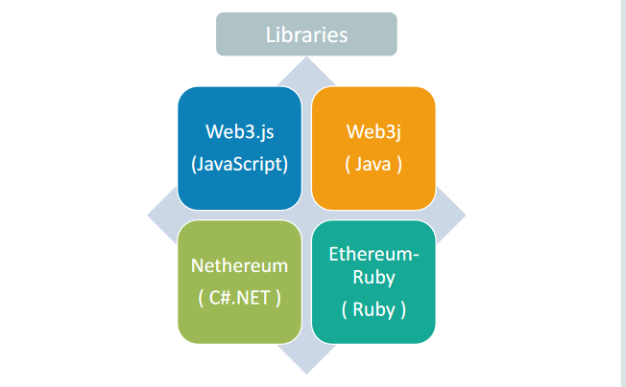
Libraries:

Slide 27
